Slide 1
Task 1 To solve any 5 XSS labs on portswigger website.
Created by- Asawari More.

Slide 2
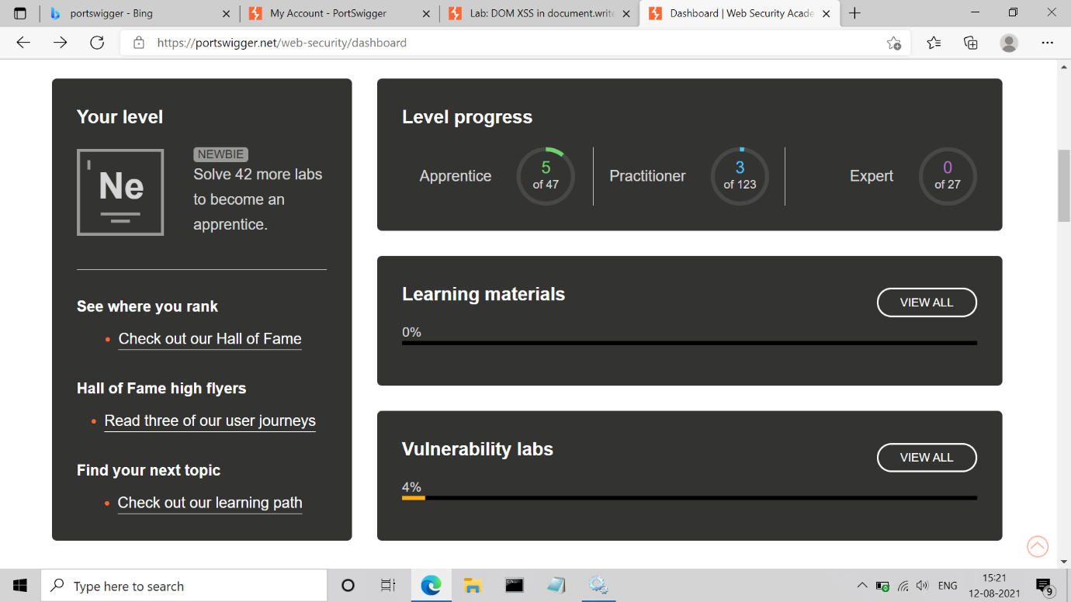

Slide 3
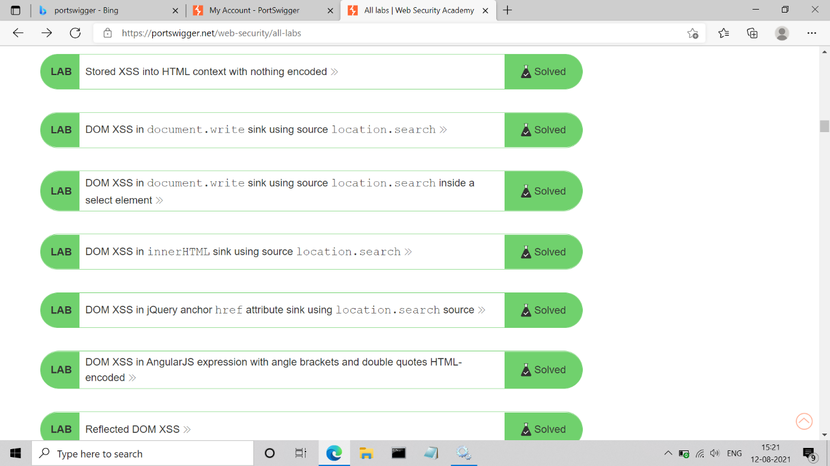

Slide 4
Thank You !!!!!

